Slide 1
Automation on FLIPKART website using Selenium and JENKINS
Presented By: Vaishnavi Adilla
Emp id-201348

Slide 2
Contents :
1.Introduction
2. Spring boot
3. Selenium
4.Testng
5.Jenkins

Slide 3
Introduction
This presentation is about the automating the website using selenium tool and shows that how we can automate the process by using different functions and we can load the site and perform various functionalities using testing framework.

Slide 4
Spring Boot
open source Java-based framework used to create a micro Service.
Spring is Light weight framework
It has Auto configuration
It is widely used in industry to create java applications ,especially in microservices
Spring initializer generally creates the skeleton with a dependency

Slide 5
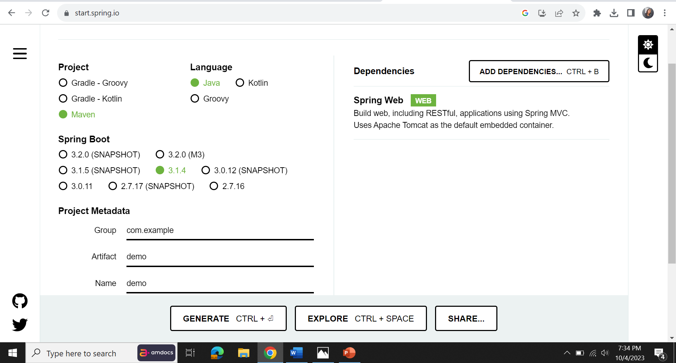
Spring boot initializer

Slide 6
Selenium
It provides the tools for automating web browsers.
It allows us to simulate user interactions and validate the functionality of web Applications .
It is widely used for web applications through browsers like chrome, Firefox, edge etc.

Slide 7
TESTNG
It is a Java-based open-source test automation framework. It covers a broader range of test categories: unit, functional, end-to-end, integration, etc
This framework is quite popular among developers and testers for test creation due to its useful features like grouping, dependence, prioritization, ease of using multiple annotations, etc.
Testng enables you to group testcases easily which is not possible in JUnit

Slide 8
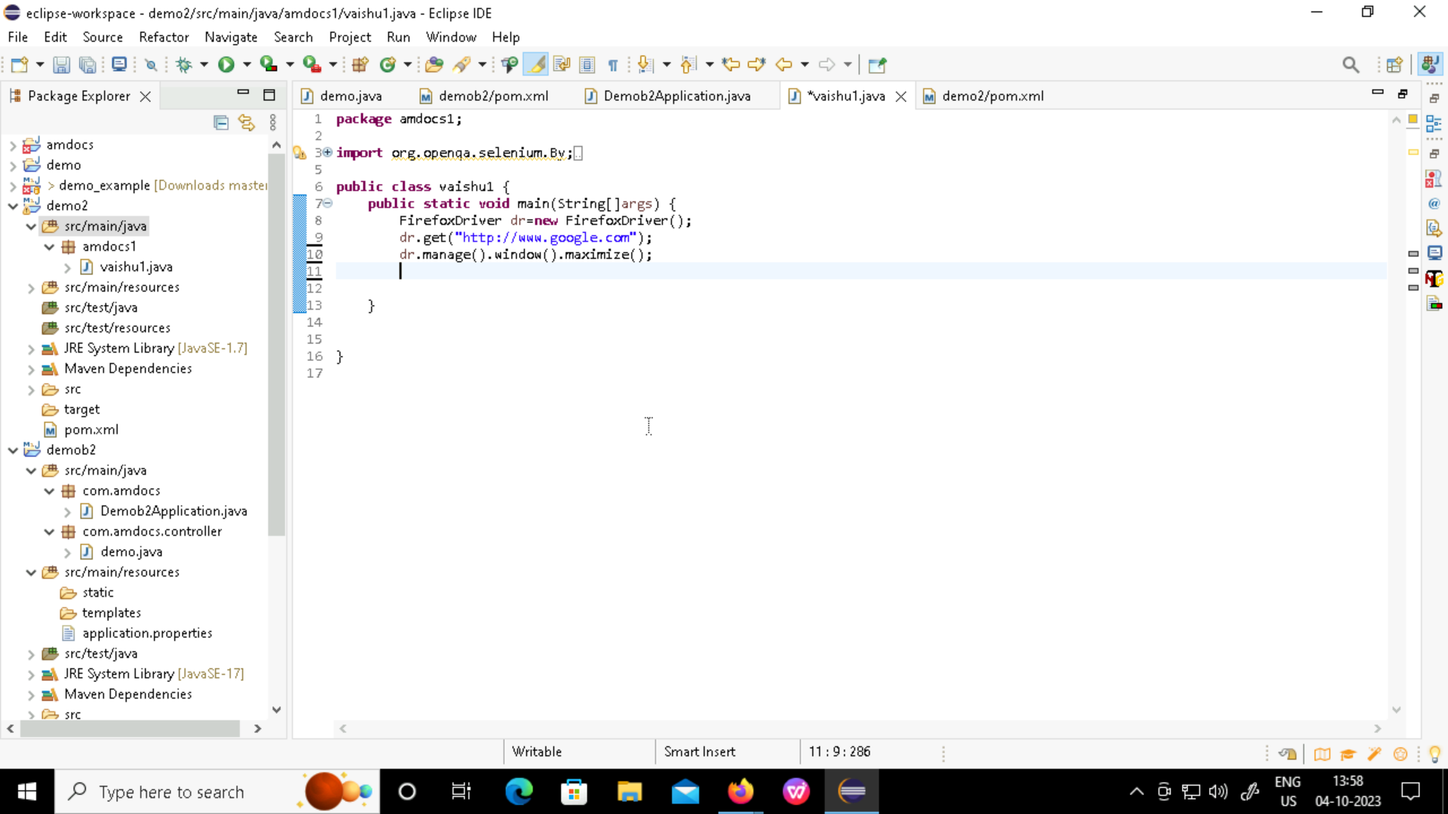
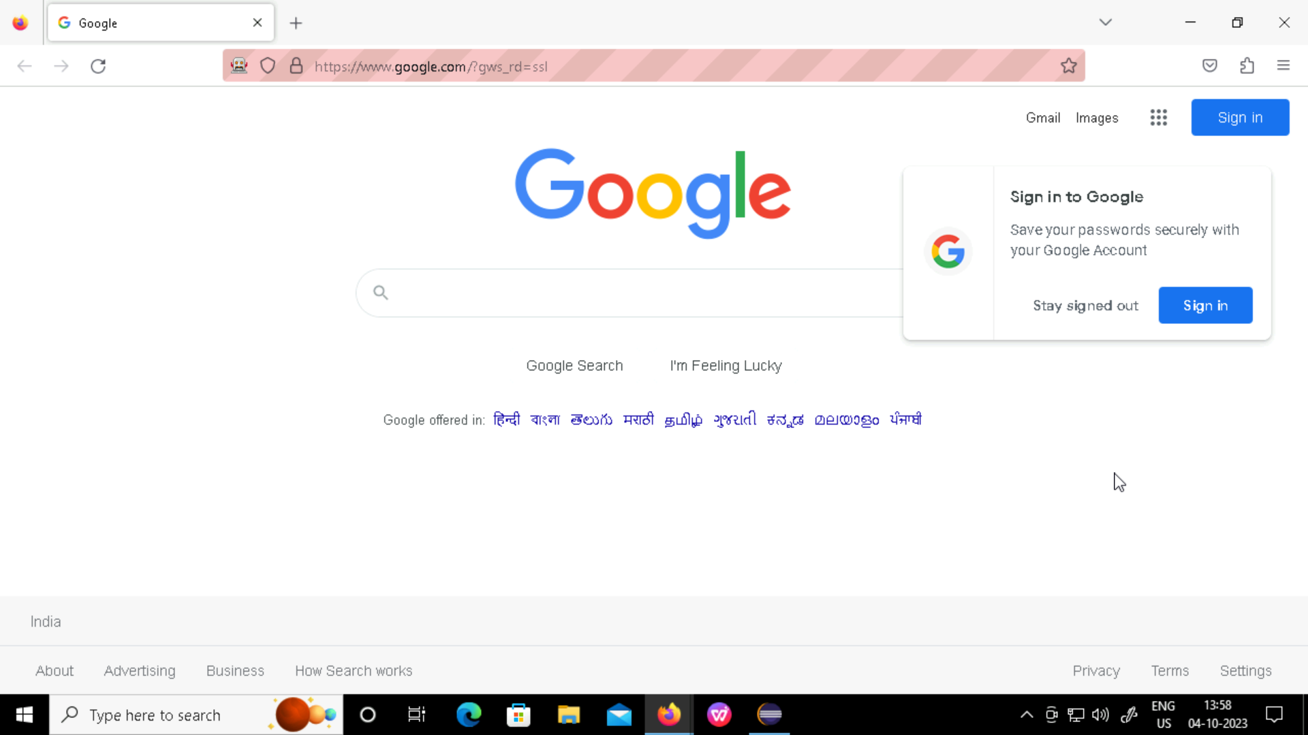
Source code: output:

Slide 9
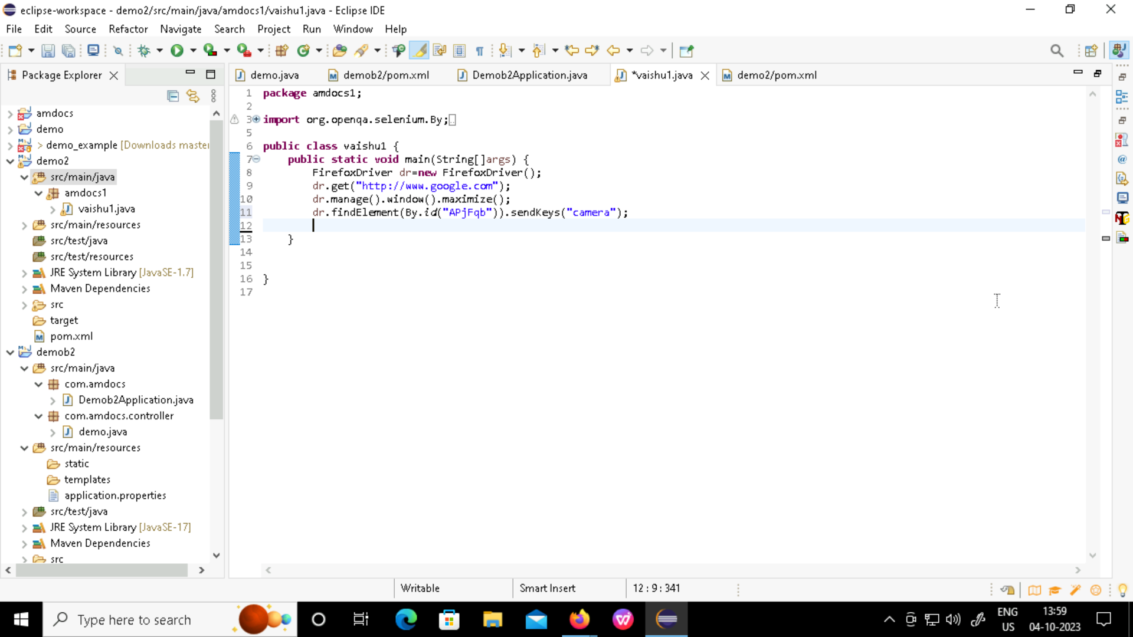
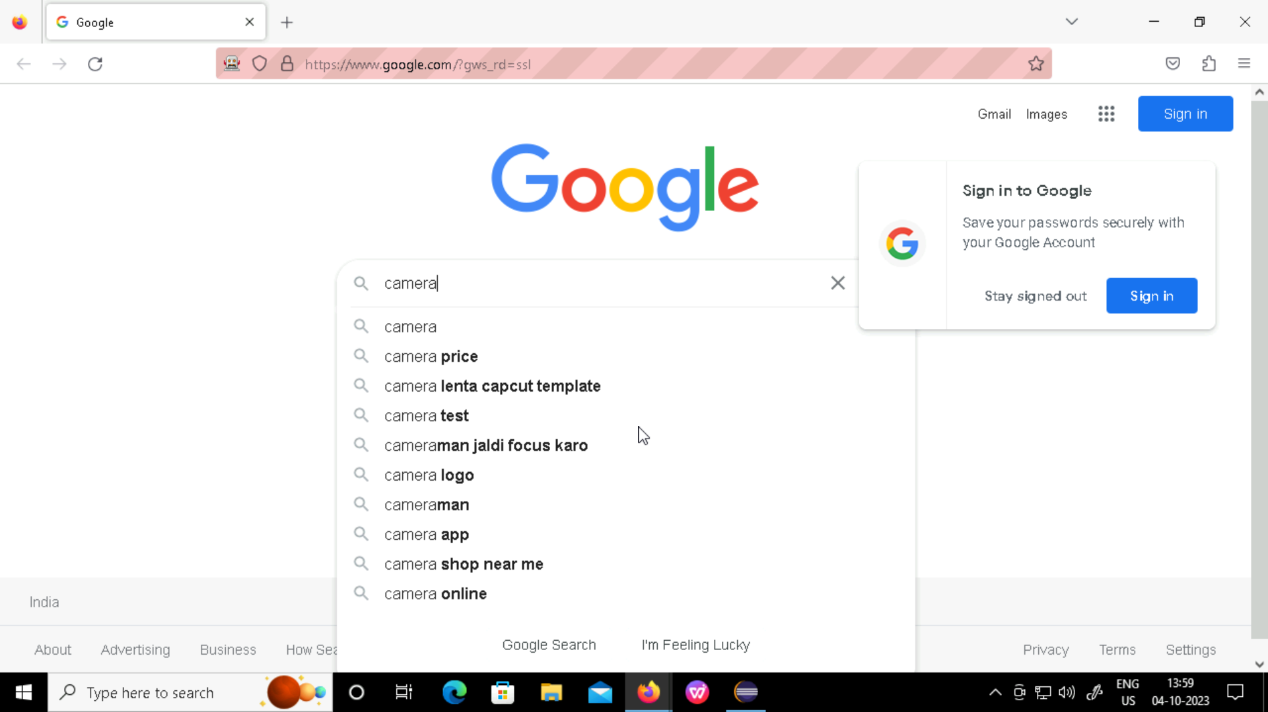
Source code: output:

Slide 10
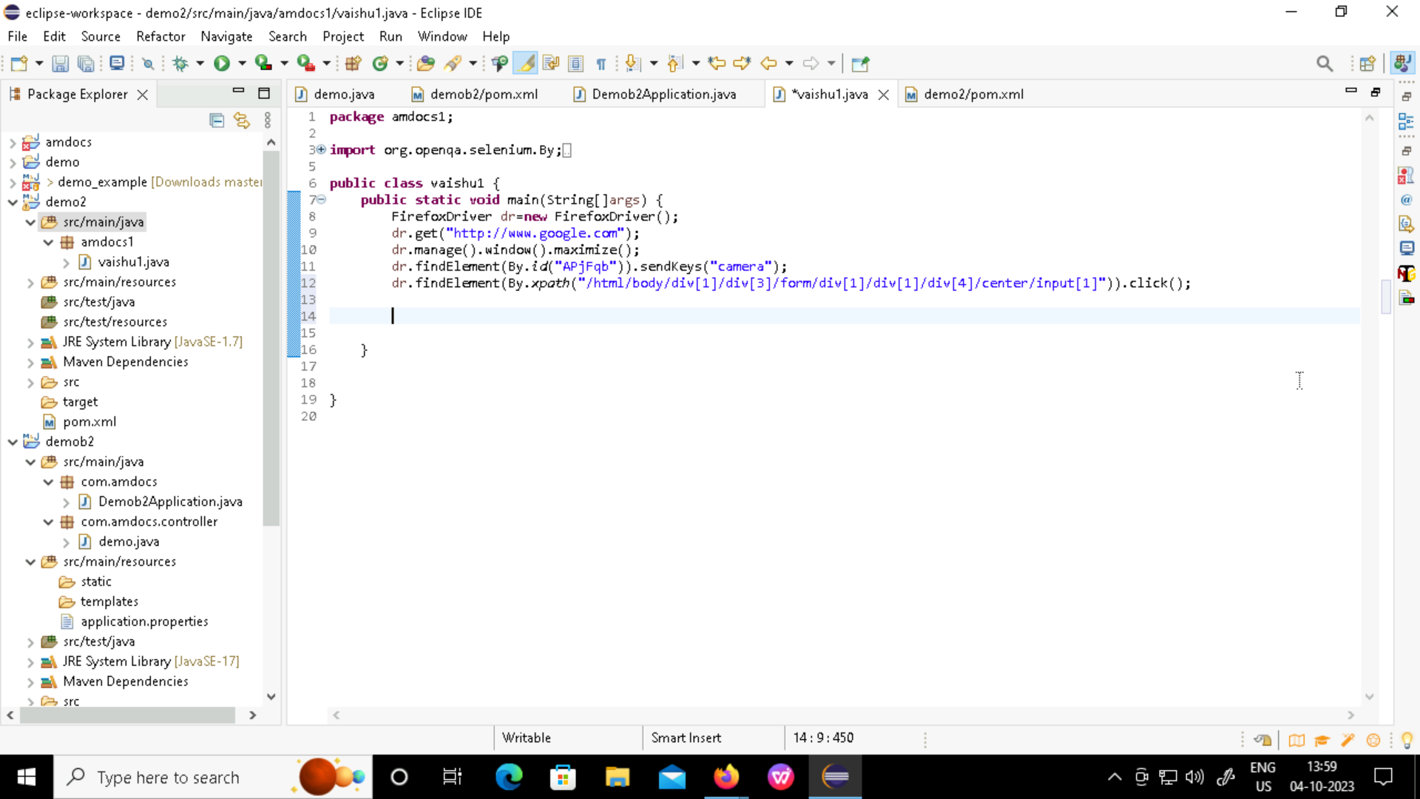
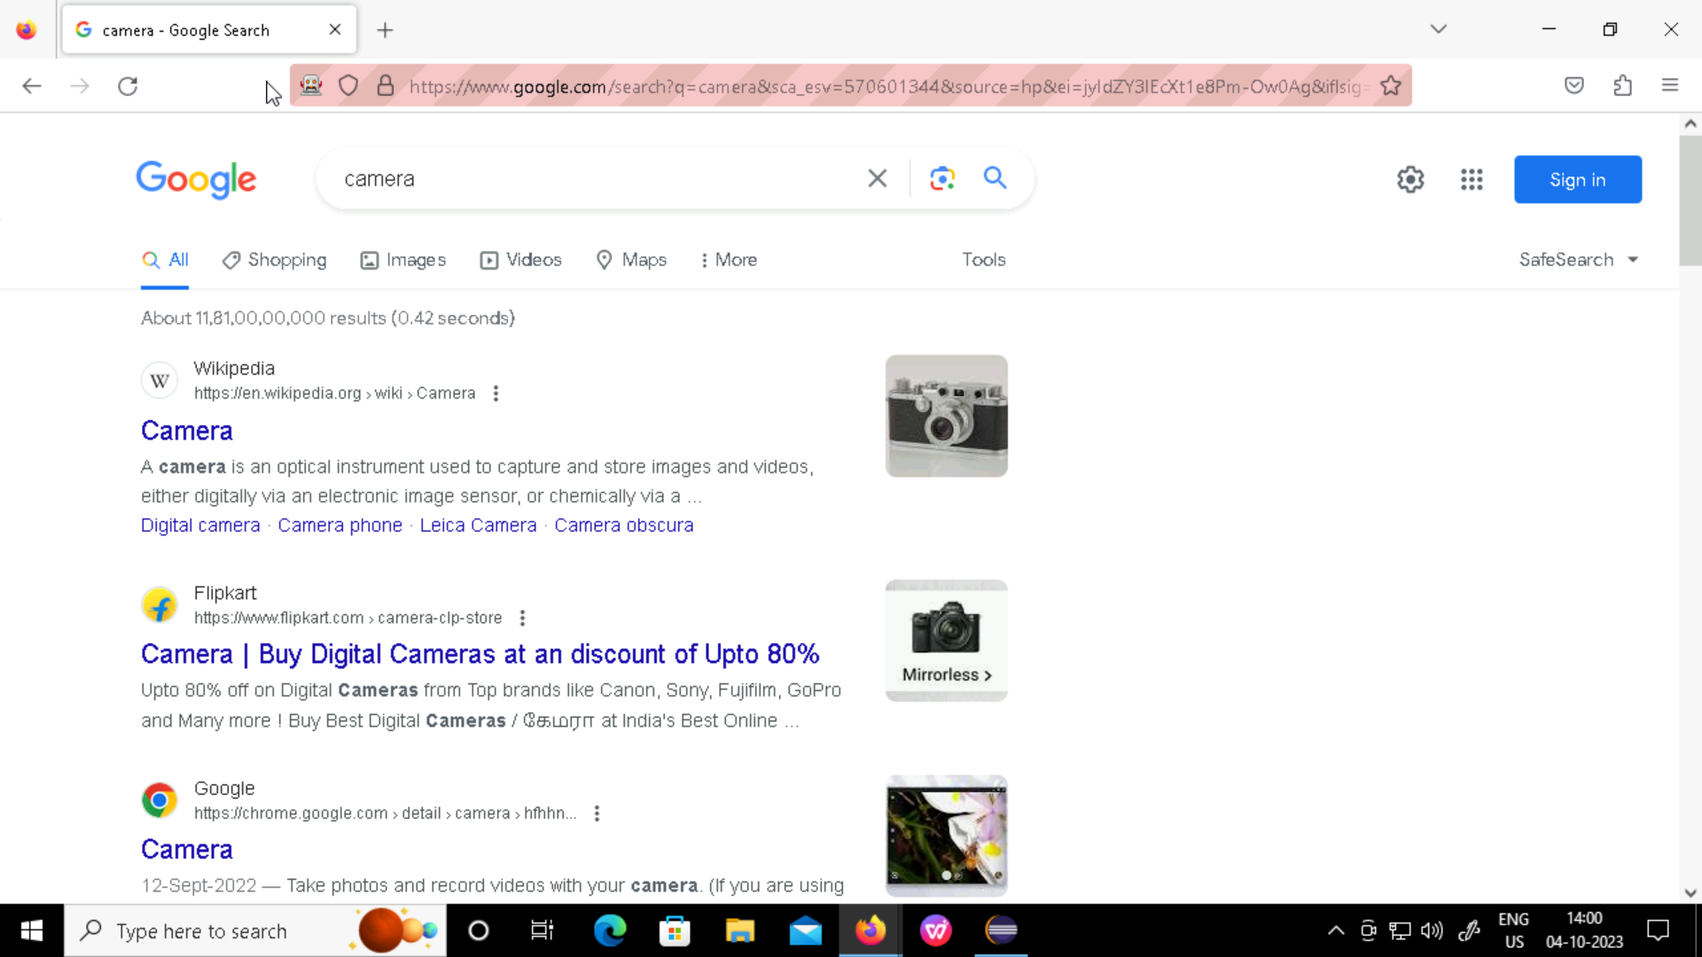
Source code: output:

Slide 11
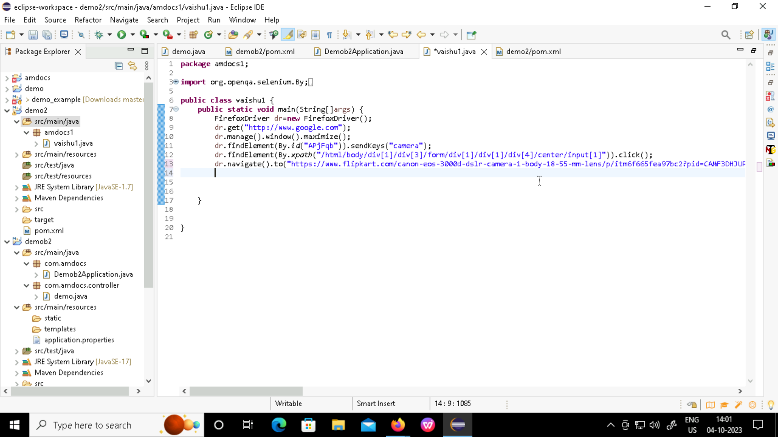
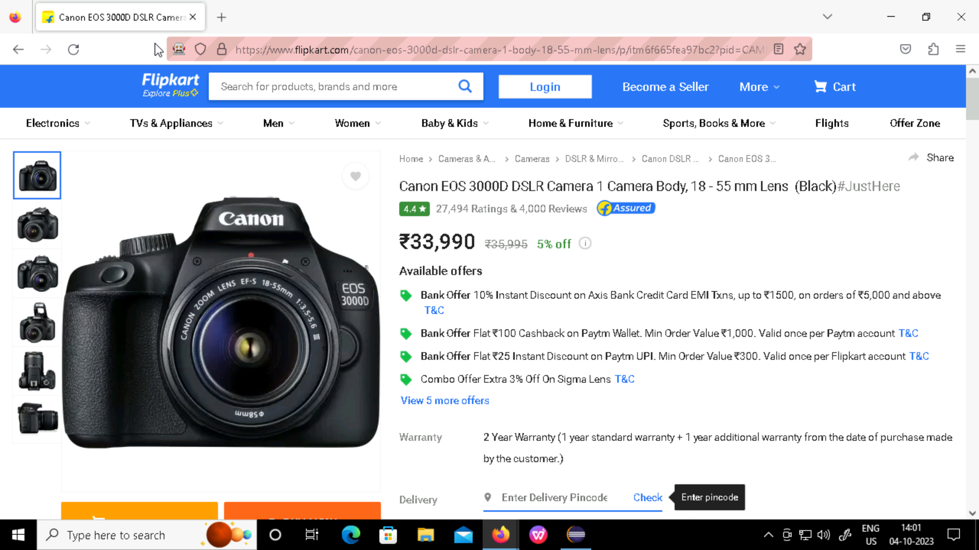
Source code: output:

Slide 12
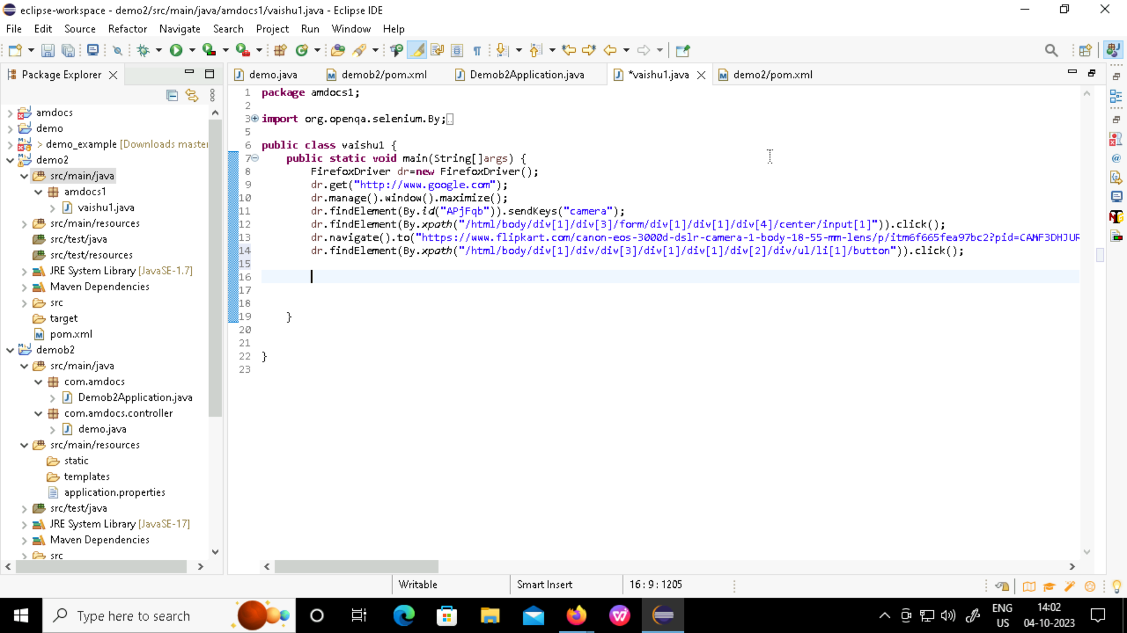
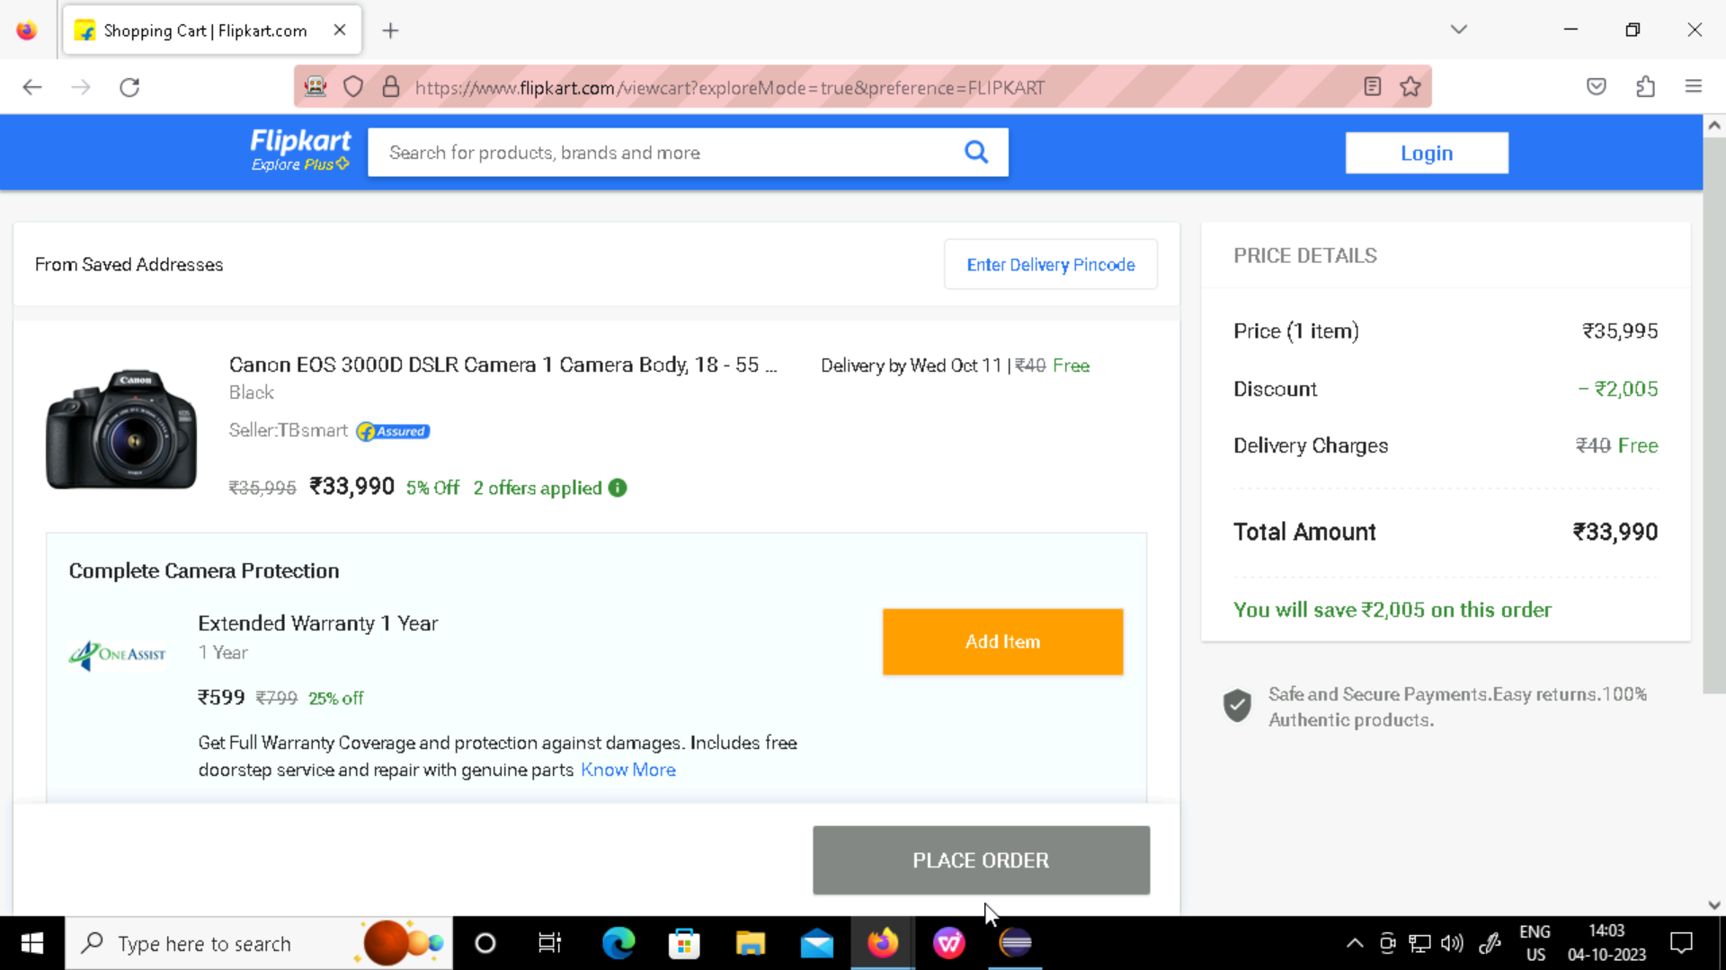
Source code: output:

Slide 13
Jenkins
Jenkins, a leading automation server , plays a pivotal role in our project by automating the build and deployment processes.
This enables continuous integration and continuous delivery ensuring that code changes are tested and deployed efficiently.

Slide 14
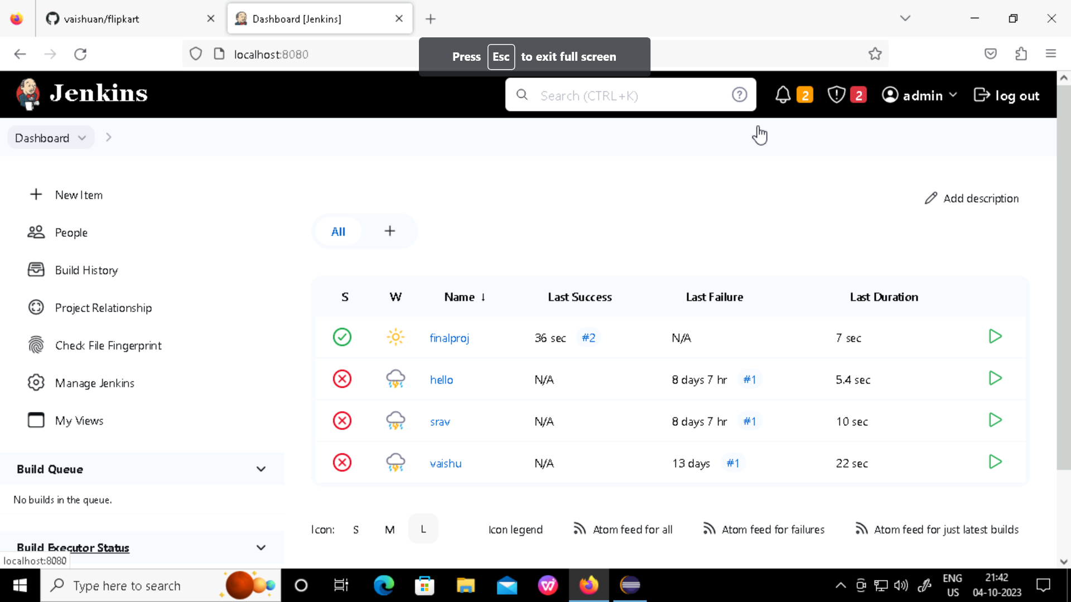
Jenkins build uI

Slide 15
Thank you

